Slide 1

Driver Drowsiness Detection System

Slide 2
A countless number of people drive on the highway day and night. Taxi drivers, bus drivers, truck drivers and people traveling long-distance suffer from lack of sleep. Due to which it becomes very dangerous to drive when feeling sleepy.
The majority of accidents happen due to the drowsiness of the driver. So, to prevent these accidents we will build a system using Python, OpenCV, and Keras which will alert the driver when he feels sleepy.
Drowsiness detection is a safety technology that can prevent accidents that are caused by drivers who fell asleep while driving.

Slide 3
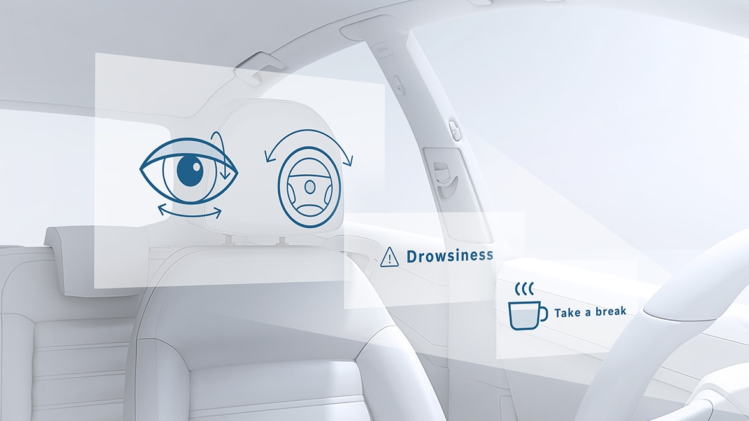
We will be using OpenCV for gathering the images from webcam and feed them into a Deep Learning model which will classify whether the person’s eyes are ‘Open’ or ‘Closed’. The approach we will be using for this Python project is as follows :
Step 1 – Take image as input from a camera.
Step 2 – Detect the face in the image and create a Region of Interest (ROI).
Step 3 – Detect the eyes from ROI and feed it to the classifier.
Step 4 – Classifier will categorize whether eyes are open or closed.
Step 5 – Calculate score to check whether the person is drowsy.

Slide 4
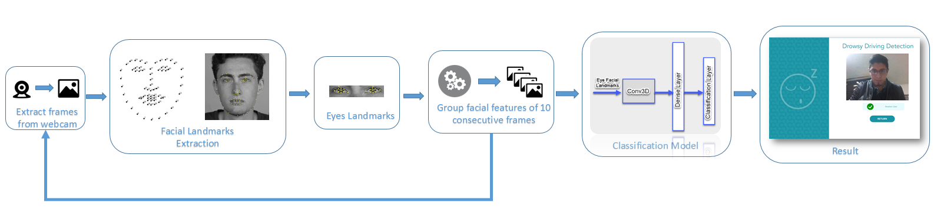

Slide 5
The Dataset
The dataset used for this model is created by us. To create the dataset, we wrote a script that captures eyes from a camera and stores in our local disk. We separated them into their respective labels ‘Open’ or ‘Closed’. The data was manually cleaned by removing the unwanted images which were not necessary for building the model. The data comprises around 7000 images of people’s eyes under different lighting conditions. After training the model on our dataset, we have attached the final weights and model architecture file “models/cnnCat2.h5”.

Slide 6
The Model Architecture
The model we used is built with Keras using Convolutional Neural Networks (CNN). A convolutional neural network is a special type of deep neural network which performs extremely well for image classification purposes. A CNN basically consists of an input layer, an output layer and a hidden layer which can have multiple numbers of layers. A convolution operation is performed on these layers using a filter that performs 2D matrix multiplication on the layer and filter.

Slide 7


Prerequisites
The requirement for this Python project is a webcam through which we will capture images. You need to have Python (3.6 version recommended) installed on your system, then using pip, you can install the necessary packages.
OpenCV – pip install opencv-python (face and eye detection).
TensorFlow – pip install tensorflow (keras uses TensorFlow as backend).
Keras – pip install keras (to build our classification model).
Pygame – pip install pygame (to play alarm sound).

Slide 8
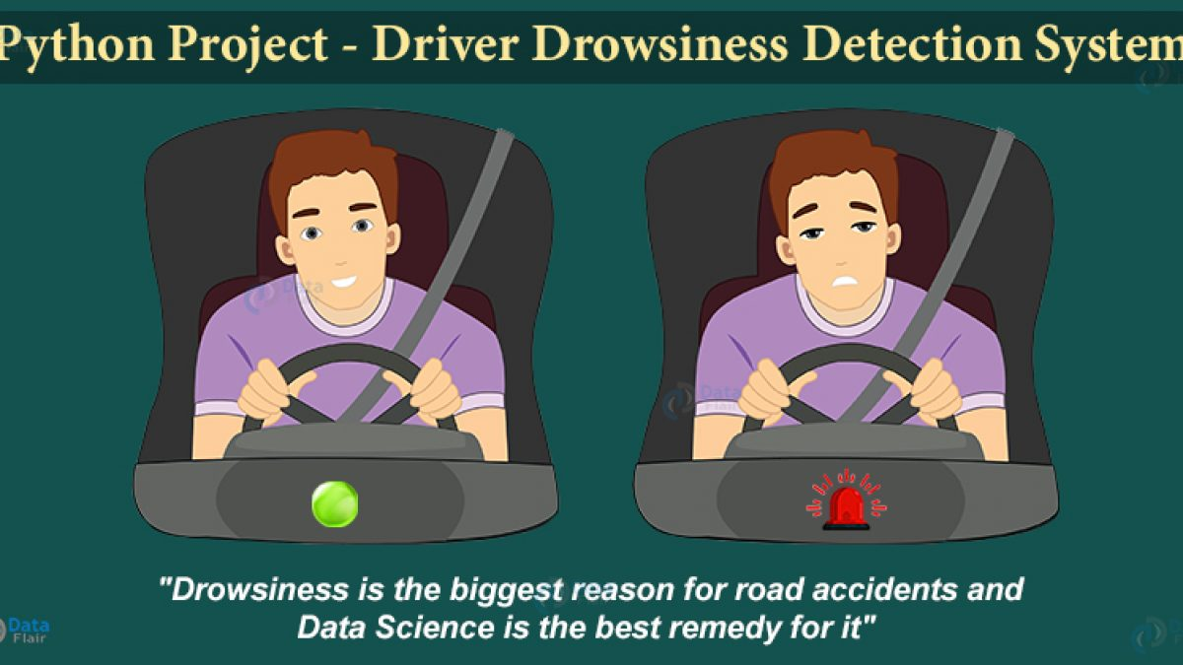
Future works:-
In the real time driver fatigue detection system it is required to slow down a vehicle automatically when fatigue level crosses a certain limit. Instead of threshold drowsiness level it is suggested to design a continuous scale driver fatigue detection system. It monitors the level of drowsiness continuously and when this level exceeds a certain value a signal is generated which controls the hydraulic braking system of the vehicle.

Slide 9
Innovation
A threshold is defined for example if score becomes greater than 15 that means the person’s eyes are closed for a long period of time. This is when the alarm using sound.play()
Alert message will reach nearest relative.
THANK YOU

